Slide 1

Modes of transfer; Priority interrupt
Computer Organization and Architecture | Memory & I/O Organization
Course: Computer Organization and Architecture | Chapter: Memory & I/O Organization | Program: Bachelor of Engineering
DISCOVER · LEARN · EMPOWER
Notes:
Welcome everyone to today's session on Memory and I/O Organization. We will focus specifically on how data moves between devices and how the CPU handles multiple interrupt requests. This is a critical topic for understanding system performance and responsiveness in real-world engineering applications.

Slide 2
Course Outcomes
SLIDE 2 / 10
Course Outcome
CO | BT LEVEL | DESCRIPTION
CO1 | BT3 | Apply number systems and digital logic to design basic digital circuits
CO2 | BT4 | Analyze register organization and instruction set architecture
CO3 | BT3 | Implement computer arithmetic algorithms and floating-point operations
CO4 | BT5 | Analyze memory hierarchy and input-output organization
CO5 | BT6 | Evaluate control unit design and pipelining performance
Chandigarh University
2 / 10
Notes:
Today's lecture directly addresses Course Outcome 4, which requires you to analyze memory hierarchy and input-output organization. By the end of this session, you will be able to evaluate different data transfer methods and prioritize interrupt signals effectively. This analysis is fundamental for designing efficient computer systems.

Slide 3
Learning Objectives
SLIDE 3 / 10
Learning Outcomes
1
Evaluate the three primary modes of data transfer between CPU and I/O devices.
2
Differentiate between programmed I/O and interrupt-driven I/O mechanisms clearly.
3
Analyze the role of DMA in reducing CPU overhead during bulk data transfers.
4
Compare various priority interrupt schemes to determine optimal system response strategies.
5
Apply priority interrupt logic to resolve conflicts when multiple devices request service simultaneously.
Chandigarh University
3 / 10
Notes:
Our goals today are to evaluate the three main transfer modes and differentiate between programmed and interrupt-driven approaches. We will analyze how Direct Memory Access reduces CPU workload and compare different priority schemes. Finally, you will apply this logic to resolve real-world device conflicts.

Slide 4
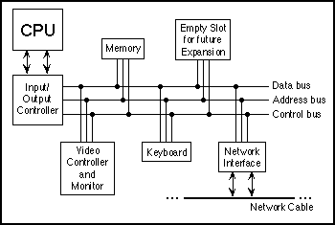
Lecture
SLIDE 4 / 10
Programmed I/O Mechanism
1
CPU executes a loop to check status flags for every single data transfer operation.
2
The processor remains busy waiting for the I/O device to become ready.
3
This method is simple but wastes significant CPU cycles during slow device operations.
4
Suitable only for very simple systems or devices with extremely fast response ×.
5
Efficiency drops drastically as the number of I/O operations increases significantly.
Javanotes 6.0, Section 1.2 -- Asynchronous Events: Polling Loops and Interrupts
Chandigarh University
4 / 10
Notes:
In Programmed I/O, the CPU acts like a guard checking a door every second. Imagine a CPU checking a printer status register 1000 × per second while the printer is still warming up. This constant polling wastes processing power that could be used for other calculations, making it inefficient for modern high-speed systems.

Slide 5
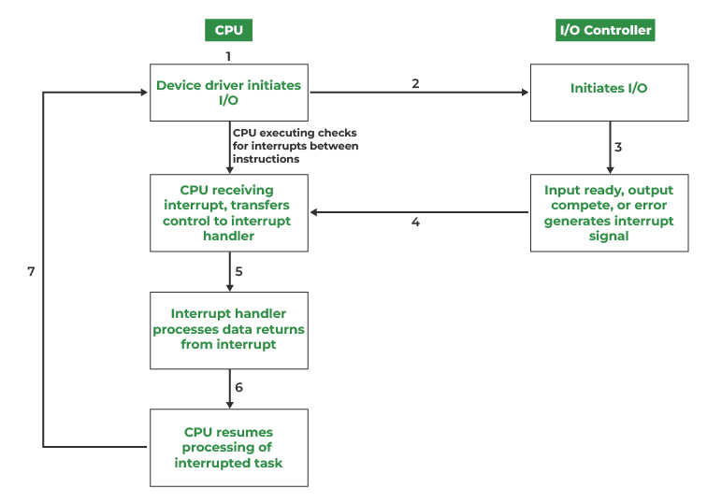
Lecture
SLIDE 5 / 10
Interrupt-Driven I/O
1
CPU initiates transfer and continues executing other instructions without waiting for completion.
2
I/O device sends a signal to the CPU only when it is ready for data.
3
CPU temporarily suspends current task to execute an Interrupt Service Routine (ISR).
4
Significantly improves CPU utilization compared to the programmed I/O method.
5
Overhead increases if interrupts occur too frequently for small data transfers.
I/O Interface (Interrupt and DMA Mode) - GeeksforGeeks (source: media.geeksforgeeks.org)
Chandigarh University
5 / 10
Notes:
Interrupt-driven I/O allows the CPU to multitask efficiently by ignoring the device until it is ready. Think of it like a chef who starts a timer for a cake and immediately starts chopping vegetables instead of staring at the oven. When the timer rings, the chef pauses to check the cake, ensuring no time is wasted waiting.

Slide 6
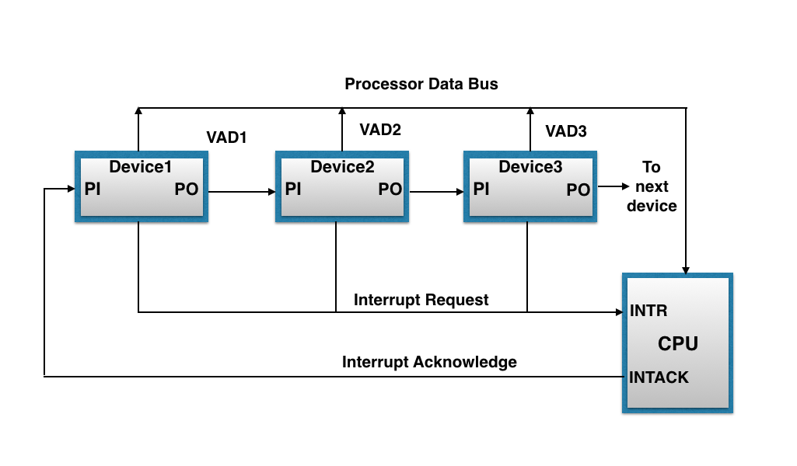
Lecture
SLIDE 6 / 10
Direct Memory Access (DMA)
1
DMA controller takes over the system bus to transfer data directly to memory.
2
CPU is released from the data transfer loop and can perform other tasks.
3
Only required for high-speed devices like disks and network cards transferring blocks.
4
DMA controller handles address generation and data movement without CPU intervention.
5
Reduces CPU overhead significantly for large volume data transfers between devices.
Computer Organisation And Architecture: COA-Priority Interrupt (source: blogger.googleusercontent.com)
Chandigarh University
6 / 10
Notes:
DMA is like hiring a moving crew to load a truck while you sit in the office managing other projects. The DMA controller acts as the foreman, moving data blocks directly between the disk and memory without the CPU lifting a finger. This is essential for high-speed devices where even interrupt overhead would be too slow.

Slide 7
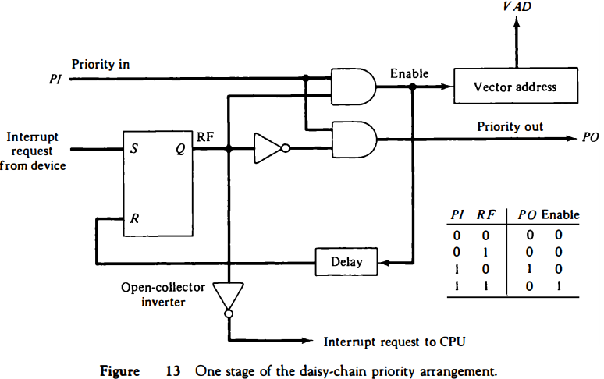
Lecture
SLIDE 7 / 10
Priority Interrupt Concepts
1
Multiple I/O devices may request service simultaneously, requiring a priority resolution scheme.
2
Higher priority devices interrupt lower priority devices to ensure critical tasks are met.
3
Priority can be fixed by hardware wiring or dynamically assigned by software.
4
Nested interrupts allow a higher priority interrupt to pause a lower priority ISR.
5
The system must ensure that the most critical operations are serviced first.
Priority Interrupt – BimStudies.Com (source: bimstudies.com)
Chandigarh University
7 / 10
Notes:
When multiple devices shout for attention at once, the system needs a rulebook to decide who speaks first. Imagine an emergency room where a trauma patient (high priority) is treated before a patient with a minor cut (low priority). This ensures that critical system functions are never delayed by less important tasks.

Slide 8
Lecture
SLIDE 8 / 10
Hardware Priority Resolution
1
Devices are connected to a priority encoder that determines the highest active request.
2
The device with the lowest physical address or highest priority line wins the bus.
3
This method is fast but inflexible as priorities are hard-wired into the circuit.
4
Interrupts are serviced in a fixed order determined by the hardware design.
5
Suitable for systems where device criticality does not change during operation.
Computer Organisation And Architecture: COA-Priority Interrupt (source: blogger.googleusercontent.com)
Chandigarh University
8 / 10
Notes:
Hardware priority resolution is like a line of people where the person at the front always gets served first, regardless of who arrived later. The device with the highest priority line connected to the encoder immediately grabs the CPU's attention. While this is very fast, it is rigid because you cannot easily change the order without rewiring the hardware.

Slide 9
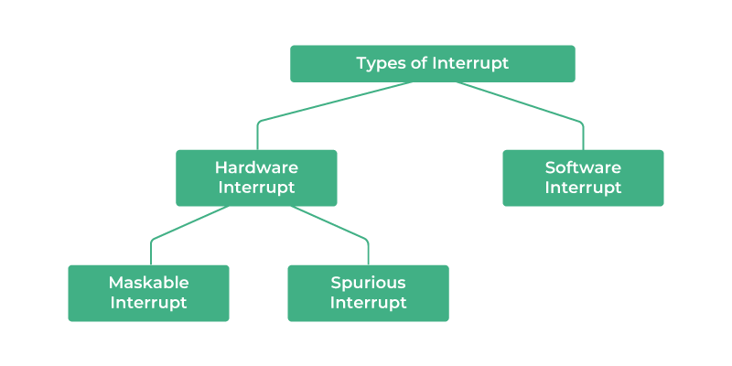
Lecture
SLIDE 9 / 10
Key Takeaways
1
Programmed I/O wastes CPU time, while Interrupt-driven I/O improves utilization.
2
DMA is essential for high-speed bulk transfers to minimize CPU overhead.
3
Priority interrupts ensure critical tasks are handled before less important ones.
4
Hardware priority is fast but rigid, whereas software priority offers flexibility.
5
Understanding these modes is vital for analyzing system performance and efficiency.
Source: media.geeksforgeeks.org
Chandigarh University
9 / 10
Notes:
To summarize, we learned that Programmed I/O is inefficient, while Interrupt-driven I/O and DMA offer significant improvements. We also explored how priority interrupts manage multiple requests to ensure critical tasks are never delayed. Remember, choosing the right mode depends on the speed of your devices and the criticality of your tasks.

Slide 10
Lecture
SLIDE 10 / 10
References
COMPUTER ORGANIZATION AND DESIGN
The Hardware/Software Interface — David A. Patterson, John L. Hennessy
COMPUTER ARCHITECTURE
A Quantitative Approach — John L. Hennessy, David A. Patterson
• Computer Organization and Architecture — William Stallings
• Computer System Architecture — M. Morris Mano & Rajib Mall
• Computer Organization — Carl Hamacher, Zvonko Vranesic, Safwat Zaky
Chandigarh University
10 / 10
Notes:
These five textbooks provide the foundational knowledge for the concepts discussed today. I encourage you to read the chapters on I/O organization in Stallings and Mano for deeper insights. These resources will help you analyze complex memory and I/O systems in your future engineering projects.

